Slide 1
Project 2 Presentation
Robbie Ritchie

Slide 2
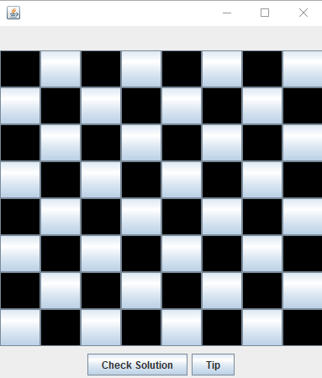
Design Decisions
Board will be a collection of buttons
Extended JButton to give extra instance variables
Allowed for easy handling of coordinates and queens
The Board itself is an extension of JPanel
It has a grid layout with a tile in each slot
It handles adding and removing queens
All other checks are made in the JFrame extension

Slide 3
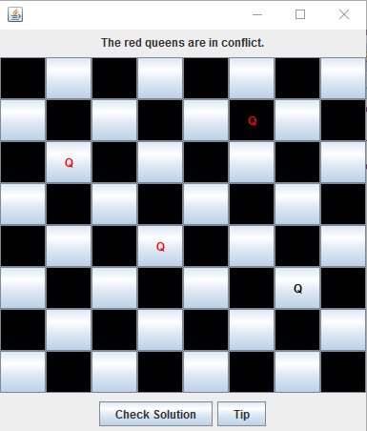
Challenges
GridLayout vs. Coordinates
Gridlayout uses a single number (0-64) while the calculations required coordinates, so I needed a way to convert between the two.
Dealing with attacking queens
The system I used made calculations easy, but visually identifying them was difficult
I ended up using a semi-complex action listener to update and clear all formatting.

Slide 4
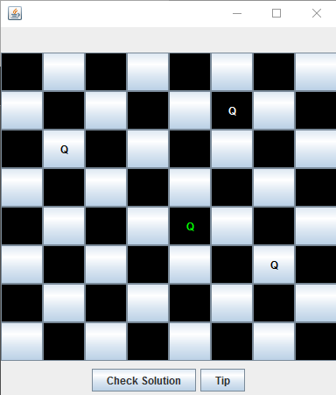
What I Learned
Planning out all of your code beforehand goes a long way
I planned out my design for the board itself, but inadvertently made the rest of the project harder
I probably would have used a single class for the board and panel if I could re-do it.
There were a lot of places where I had a few different solutions in mind, looking back I know which ones were best now

Slide 5

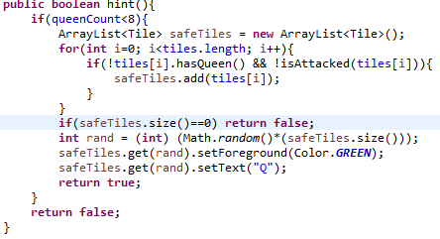
Interesting Features
Determining a tile’s color
Code for Determining where to put a tip

